Slide 1
Grafică asistată de calculator
Laborator – Grigore Ionuț

Slide 2
Laboratory 3
Adding Captions
to Images

Slide 3
What We'll Do Today
Flickr 8k Dataset
TransformerBlock
01
Download Flickr 8k from Kaggle, split 7K train / 1K test images, each with 5 human-written captions
04
Single class serving both encoder and decoder
Patch Extraction & Positional Encoding
VisionEncoderDecoder
02
Slice 128×128 images into 256 non-overlapping 8×8 patches using Unfold; add learned positional embeddings
05
Full model: ViT encoder produces image embeddings; text decoder generates token logits via teacher forcing
AttentionBlock
Training & Captioning
03
Reusable attention layer — use masking for decoder attention, no masking for encoder and attention
06
Train the model to predict the next caption token; at inference, generate captions word by word until <end> token

Slide 4
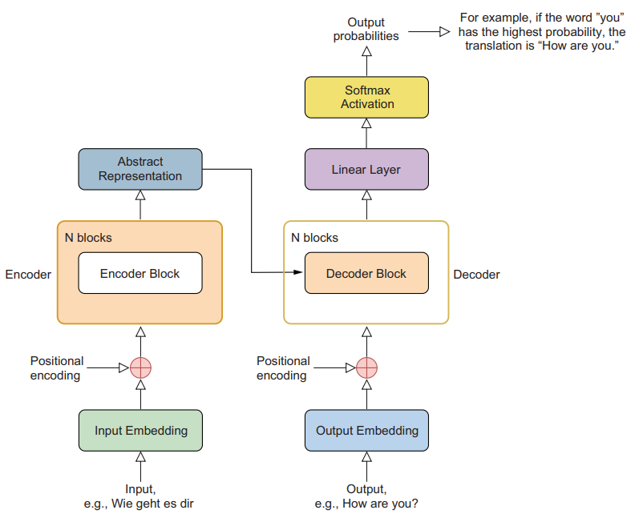




Recap lab 1 – Translating from German to English with a Transformer
How
The decoder:
starts with a BOS token
predicts the next token (e.g. How)
then feeds the generated token back into the model
repeats the process until an EOS token is produced.
Example generation: <BOS> → How → are → you → ? → <EOS>
<BOS>

Slide 5
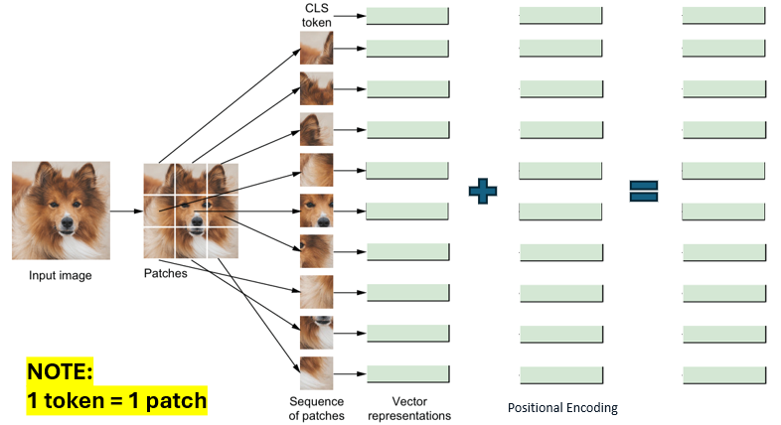

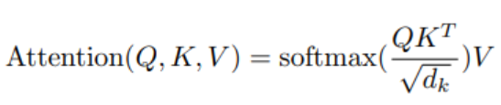
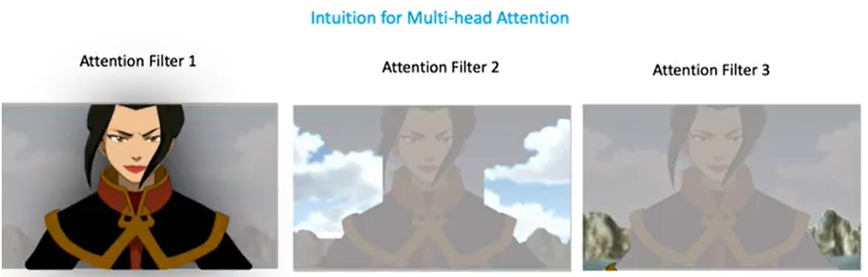

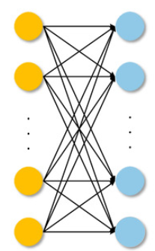
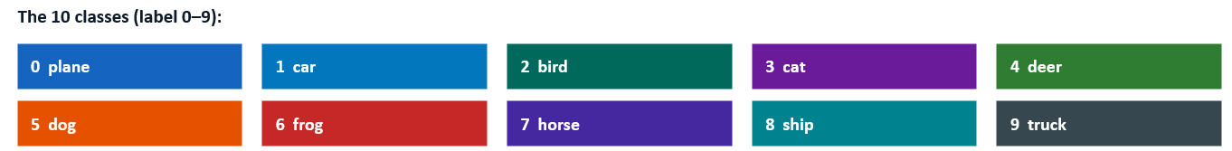
Recap lab 2 - Classifying Images with a Vision Transformer
Transformer Encoder
48
10
Linear Layer

Slide 6
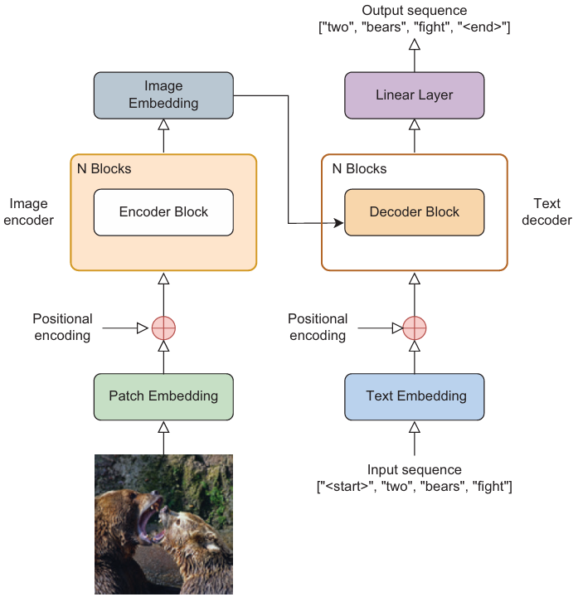

Lab 3 – Adding Captions to Images
two
The decoder:
starts with a <start> token
predicts the next token (e.g. two)
then feeds the generated token back into the model
repeats the process until an <end> token is produced.
Example generation: <start> → two → bears → fight → <end>
<start>

Slide 7
Section 1
Preparing the Flickr 8k Dataset

Slide 8
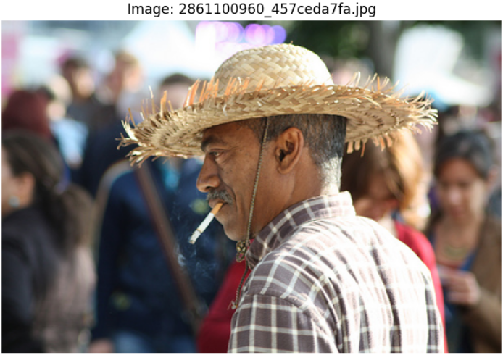
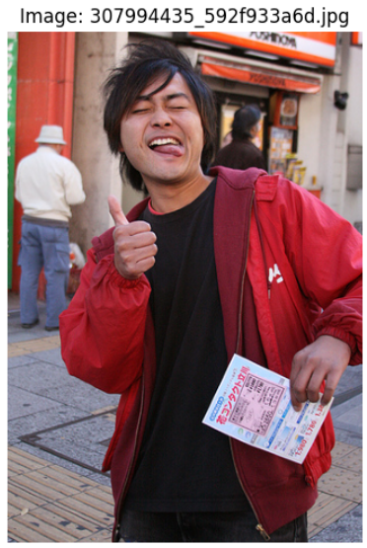
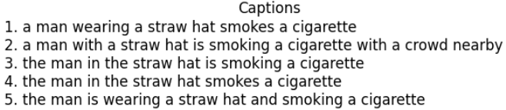
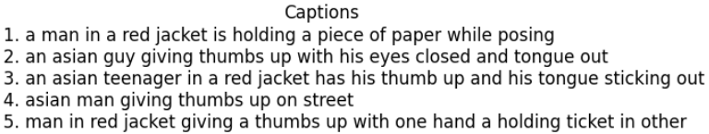
§1
Flickr 8k Dataset Overview
8,000
5
7,000
1,000
Images
Captions per image
Training images
Test images
for ...:
# details
# details
train_image_paths.append(path) # 7,000 training images
train_image_captions.append(captions)
# details
test_image_paths.append(path) # 1,000 test images
test_image_captions.append(captions)
💡 Each image has 5 independent captions from different annotators — giving the model diverse descriptions of the same scene to learn from.

Slide 9
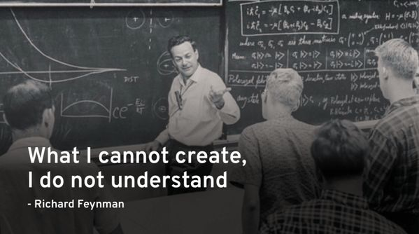

The laboratory does not include a function for plotting images together with their captions. However, we can use AI tools such as Copilot / ChatGPT / Claude to quickly generate such code.
This is useful because visualizing the dataset helps us:
verify that the data is loaded correctly,
understand the structure of the dataset,
get an intuitive sense of the images and captions before training.
Exploring the data visually is an important step in any machine learning project !

Slide 10
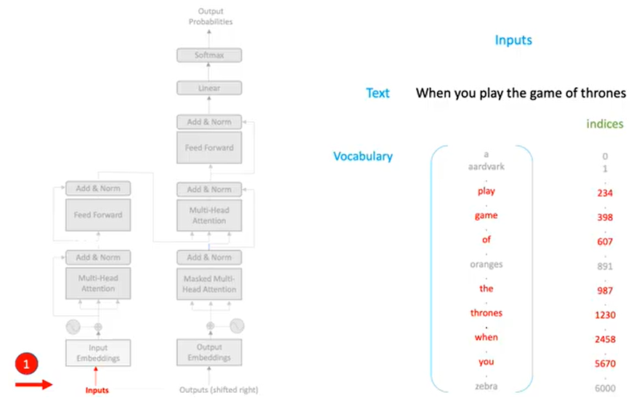
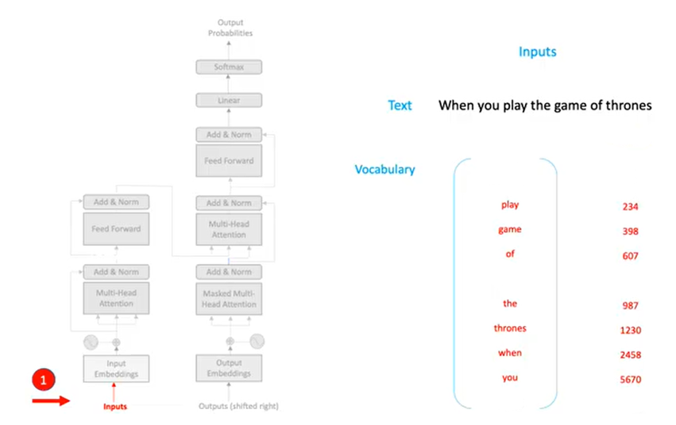
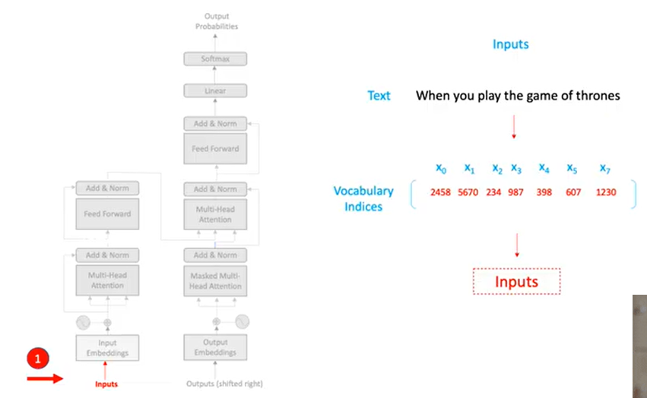

§1
Building the Vocabulary
Kind reminder from last BIA lab ☺

Slide 11
§1
Building the Vocabulary
TL;DR — Creating the vocabulary
Read all captions from the dataset
Count how many times each word appears
Keep only the words that appear often enough
Assign an index to each word: word → idx
Add special tokens:
<pad> for padding
<start> beginning of sentence
<end> end of sentence
<unk> unknown word
Result: vocabulary used by the model to convert text into numbers

Slide 12
§1
Building the Vocabulary
words = [w for w in word_freq.keys() if word_freq[w] > 0]
word2idx = {k: v + 4 for v, k in enumerate(words)} # regular words start at index 4
word2idx['<pad>'] = 0
word2idx['<start>'] = 1
word2idx['<end>'] = 2
word2idx['<unk>'] = 3
idx2word = {v: k for k, v in word2idx.items()} # reverse: integer → token
print(f"there are {len(idx2word)} unique tokens")
Token
Index
Role
<pad>
0
Pads short captions to the same length in a batch
<start>
1
Appended to input — starts decoder generation
<end>
2
Appended to target — stops decoder generation
<unk>
3
Replaces any token not found in word2idx
Output
there are 8387 unique tokens
💡 Regular word indices start at 4. The first 4 slots are reserved for special tokens. idx2word reverses the mapping: integer → English word.

Slide 13
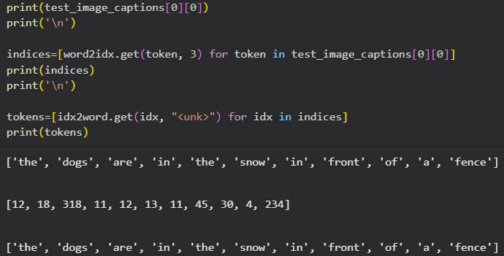
§1
Building the Vocabulary
Example:

Slide 14

§1
FlickrD — Custom PyTorch Dataset
Class FlickrD(Dataset):
def __init__(...):
...
# other functions here
def __getitem__(...):
...
return image_tensor, input_tokens, tgt_tokens, attn_masks
image_tensor
(128, 3, 128, 128)
128 RGB images, 128×128 pixels each
input_tokens
(128, 50)
Input sequences: <start> + caption tokens
tgt_targets
(128, 50)
Target sequences: caption tokens + <end>
attn_mask
(128, 50)

Slide 15
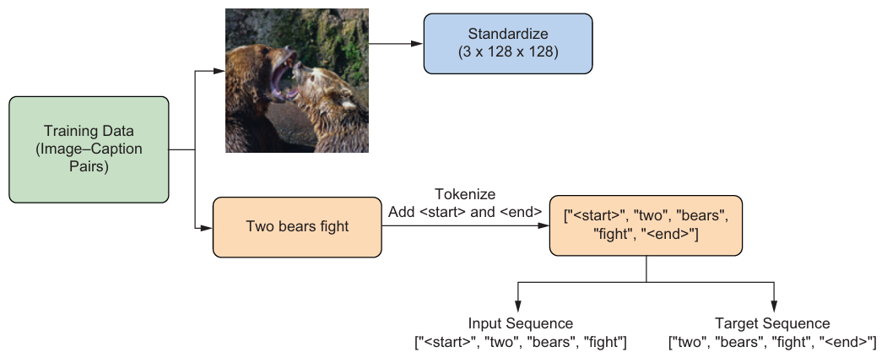

§1
FlickrD — Custom PyTorch Dataset

Slide 16
§1
FlickrD — Custom PyTorch Dataset
TL;DR
We shift the sentence by one position
Input → what the model sees
Target → what the model should predict
Training teaches the model to generate captions word-by-word

Slide 17
Try to focus on the big picture and not get lost in details

Slide 18
Section 2
Patch Extraction & Positional Encoding

Slide 19
§2
extract_patches() — Images as Sequences of Tokens
def extract_patches(image_tensor, patch_size=8):
bs, c, h, w = image_tensor.size()
unfold = torch.nn.Unfold(kernel_size=patch_size, stride=patch_size)
unfolded = unfold(image_tensor)
unfolded = unfolded.transpose(1, 2).reshape(bs, -1, c * patch_size * patch_size)
return unfolded
Input image
After Unfold
After transpose
(1, 3, 128, 128)
→
(1, 192, 256)
→
(1, 256, 192)
Why 256 patches?
Why 192 pixel values?
How Unfold works
128 ÷ patch_size(8) = 16 patches per side
16 × 16 = 256 patches per image
Each patch covers an 8×8 pixel area.
3 channels (R, G, B)
× 8 × 8 pixels per patch
= 192 raw values per patch.
Unfold(kernel_size=8, stride=8) slides an 8×8 window with no overlap, extracting each block as a flat 192-dim vector.

Slide 20
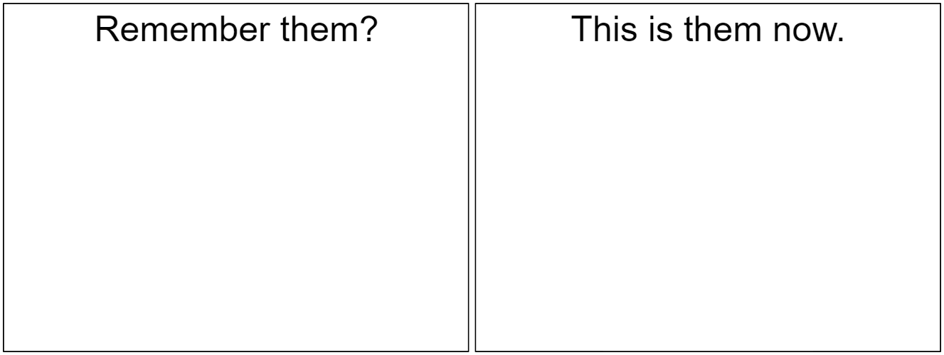
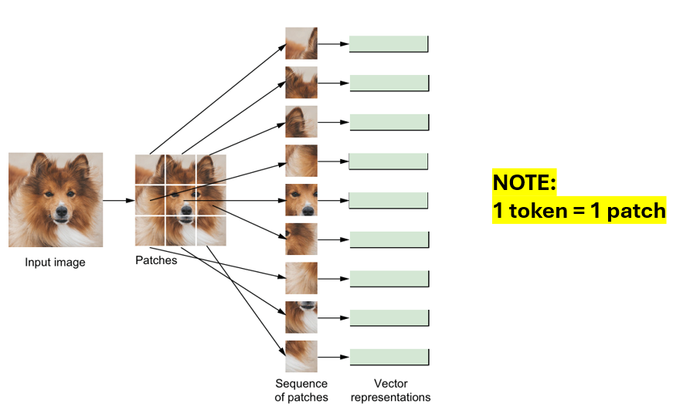
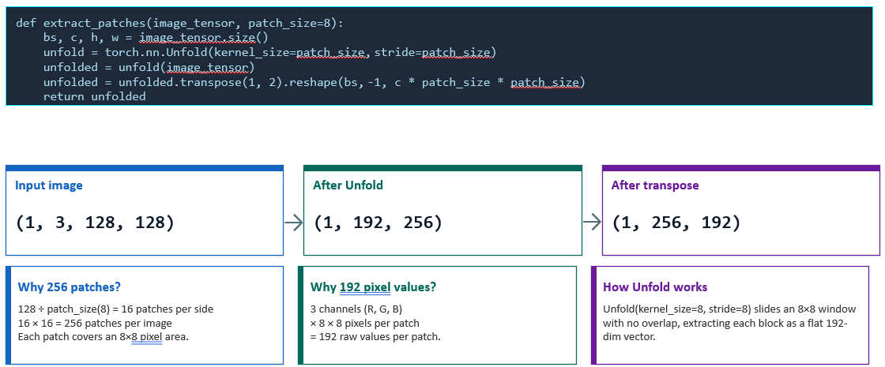

Slide 21

§2
SinusoidalPosEmb — Fixed Positional Encoding
class SinusoidalPosEmb(nn.Module):
def __init__(self, dim):
self.dim = dim
def forward(self, x):
half_dim = self.dim // 2
emb = math.log(10000) / (half_dim - 1)
emb = torch.exp(torch.arange(half_dim) * -emb)
emb = x[:, None] * emb[None, :]
emb = torch.cat((emb.sin(), emb.cos()), dim=-1)
return emb
Why positional encoding?
Sinusoidal formula
Transformers process all tokens in parallel — they have no built-in sense of order. Positional encoding injects position information into each embedding.
PE(pos, 2i) = sin(pos / 10000^(2i/d))
PE(pos, 2i+1) = cos(pos / 10000^(2i/d))
Each dimension encodes a different frequency.

Slide 22
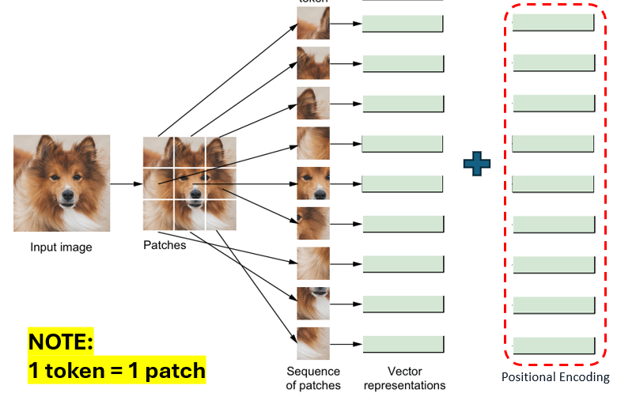
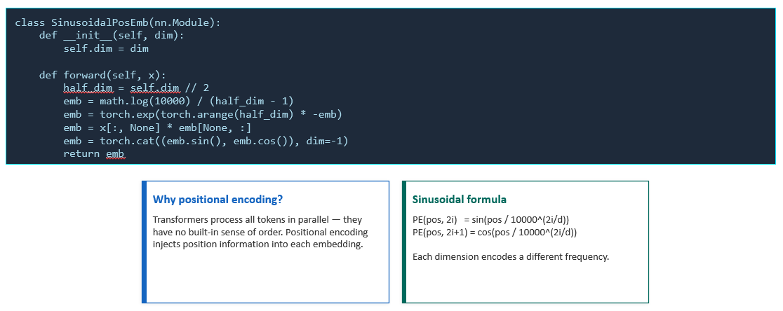

Slide 23
Try to focus on the big picture and not get lost in details

Slide 24
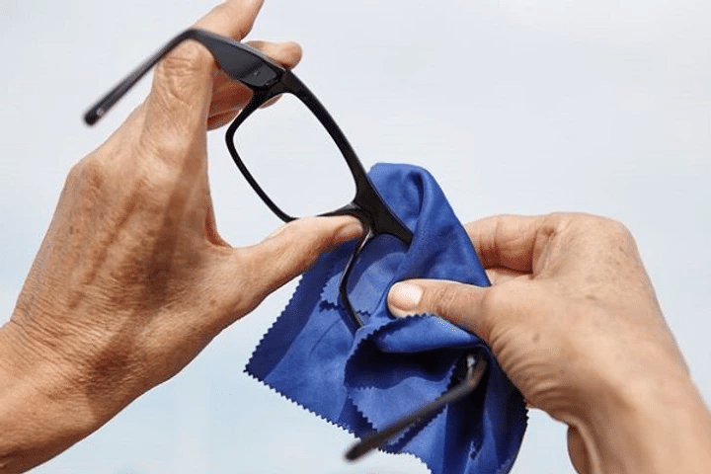
class SinusoidalPosEmb(nn.Module):
def __init__(self, dim):
self.dim = dim
def forward(self, x):
half_dim = self.dim // 2
emb = math.log(10000) / (half_dim - 1)
emb = torch.exp(torch.arange(half_dim) * -emb)
emb = x[:, None] * emb[None, :]
emb = torch.cat((emb.sin(), emb.cos()), dim=-1)
return emb
def extract_patches(image_tensor, patch_size=8):
bs, c, h, w = image_tensor.size()
unfold = torch.nn.Unfold(kernel_size=patch_size,
stride=patch_size)
unfolded = unfold(image_tensor)
unfolded = unfolded.transpose(1, 2).reshape(bs,
-1, c * patch_size * patch_size)
return unfolded

Slide 25
Section 3
AttentionBlock

Slide 26

§3
AttentionBlock — One Reusable Class
class AttentionBlock(nn.Module):
def __init__(self, hidden_size=128, num_heads=4, masking=True):
self.multihead_attn = nn.MultiheadAttention(hidden_size, num_heads=num_heads, ...)
def forward(self, ...):
...

Slide 27
Section 4 + 5
TransformerBlock &
VisionEncoderDecoder

Slide 28
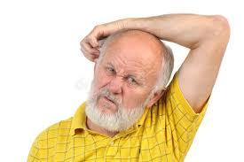
two
class TransformerBlock(nn.Module):
...
class VisionEncoder(nn.Module):
...
class Decoder(nn.Module):
...
<start>
class VisionEncoderDecoder(nn.Module):
...

Slide 29
Section 6
Training & Captioning

Slide 30
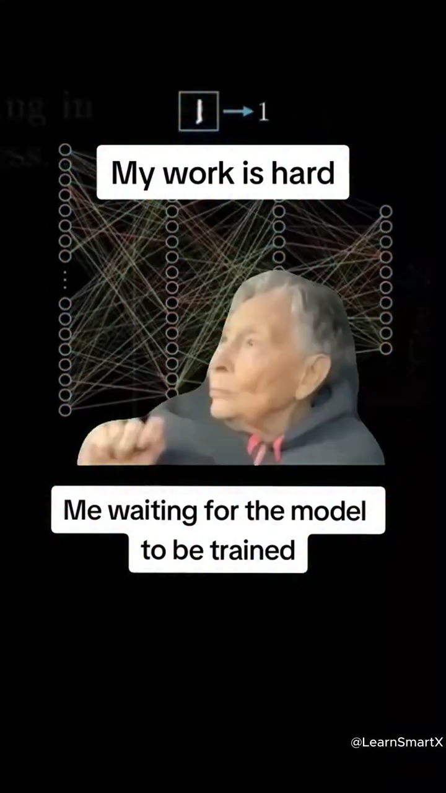
§6
Training the Model — 50 Epochs
optimizer = torch.optim.Adam(caption_model.parameters(), lr=0.0001)
loss_fn = nn.CrossEntropyLoss(reduction="none")
scaler = torch.amp.GradScaler("cuda")
for epoch in range(50):
caption_model.train()
for images, inputs, outputs, masks in train_loader:
with torch.amp.autocast("cuda"):
pred = caption_model(images, inputs, padding_mask=masks)
loss = (loss_fn(pred.transpose(1,2), outputs) * masks).mean()
optimizer.zero_grad()
scaler.scale(loss).backward()
scaler.step(optimizer)
scaler.update()
torch.save(caption_model.state_dict(), "files/caption.pth")

Slide 31
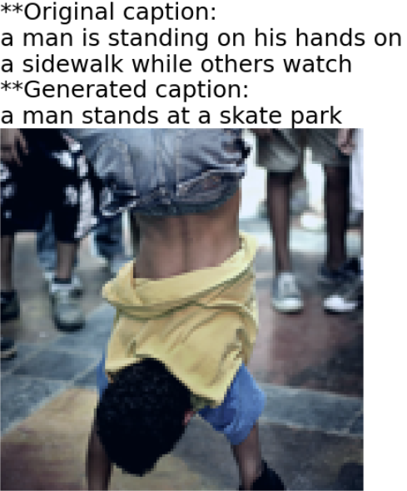

§6
Autoregressive Caption Generation
# Function that generates a caption for an image using the trained Transformer model
def caption(image, ...):
...
return pred_text
# Function that displays an image together with the original caption and the generated caption
def compare(images, caption, ...)
...
**Original caption:
darling trili frili longsong
**Generated caption:
a porcupine playing an accordion

Slide 32
Try to focus on the big picture and not get lost in details

Slide 33
Lab Exercises
1
Tokenise the third caption for the second test image
Convert the tokens in the third caption for the second image in the test set into integers. Name the result indices2 and print it.
Hint: indices2 = [word2idx.get(token, 3) for token in test_image_captions[1][2]] # [1]=2nd image, [2]=3rd caption
print(indices2)
2
Convert indices2 back to tokens using idx2word
Use the idx2word dictionary to translate the integer sequence from Exercise 1 back into English tokens.
Hint: tokens2 = [idx2word.get(idx, '<unk>') for idx in indices2]
print(tokens2) # should recover the original English words
3
Generate a caption for the 10th test image at temp = 0.95
Apply compare() on the 10th image in the test set with temp=0.95. Compare the result with the default temp=0.75 used in the notebook demo.
Hint: compare(test_images, test_tokens, index=9, temp=0.95) # index=9 → 10th image (0-indexed)

Slide 35
Ex 1
Tokenise the Third Caption for the Second Test Image
❓ Convert the tokens in the third caption for the second image in the test set into integers. Name the sequence indices2 and print it.
# test_image_captions[image_index][caption_index]
# [1] = second image (0-indexed: 0 = 1st, 1 = 2nd, ...)
# [2] = third caption (0-indexed: 0 = 1st, 1 = 2nd, 2 = 3rd)
indices2 = [word2idx.get(token, 3) for token in test_image_captions[1][2]]
# word2idx.get(token, 3):
# • returns word2idx[token] if the token is in the vocabulary
# • returns 3 (<unk>) if the token is NOT in the vocabulary
print(indices2)
Output
indices2 → [4, 6, 1761, 11, 4, 713, 75, 4, 94] (one integer per token)
test_image_captions[1][2]
word2idx.get(token, 3)
test_image_captions is structured as:
[img0_captions, img1_captions, ...]
Each is a list of up to 5 captions.
[1] = 2nd image, [2] = 3rd caption.
dict.get(key, default) returns the
value if key exists, else default.
Using 3 maps unknown words to
<unk> instead of raising KeyError.
💡 test_image_captions[0][0] = first caption of the first image. Change the first index to select the image, and the second to select the caption (both 0-indexed).

Slide 36
Ex 2
Convert indices2 Back to Tokens Using idx2word
❓ Use the idx2word dictionary to convert the integer sequence from Exercise 1 back into English tokens.
# idx2word is the reverse of word2idx:
# idx2word = {v: k for k, v in word2idx.items()}
tokens2 = [idx2word.get(idx, "<unk>") for idx in indices2]
print(tokens2) # list of string tokens
# Bonus: join into a readable sentence
print(" ".join(tokens2))
Output
tokens2 → ['a', 'dog', 'swims', 'in', 'a', 'pool', 'near', 'a', 'person']
" ".join(tokens2) → "a dog swims in a pool near a person"
word2idx (str → int)
idx2word (int → str)
Maps every English word to a unique integer.
Built from word_freq.
Special tokens hardcoded at indices 0–3.
Used to tokenise captions before training.
The exact reverse: {v: k for k, v in word2idx.items()}.
Used at inference time to convert predicted integer indices back to readable English words.
Also used in compare() to show the original caption.
💡 The reverse comprehension works because word2idx values are unique integers — every index maps to exactly one word, so swapping keys and values is always safe.

Slide 37
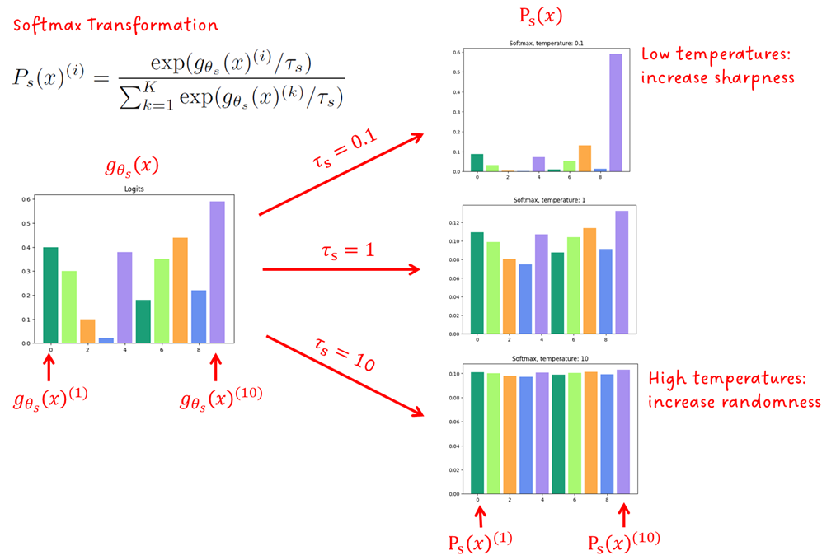









Ex 3
Generate a Caption for the 10th Test Image at temp = 0.95
❓ Apply the compare() function on the 10th image in the test set, and set the temp argument to 0.95.
compare(test_images, test_tokens, index=9, temp=0.95)
# index=9 → 10th image (0-indexed: 0,1,2,...,9)
# temp=0.95 → slightly more creative than demo's 0.75
Temperature adjusts the distribution of probabilities assigned to each potential token before selecting the next one.
It effectively scales the logits, which are the inputs to the softmax function calculating these probabilities, by the value of the temperature.
When the temperature is greater than 1, this makes the softmax probabilities more uniform, meaning the model is more likely to sample less likely tokens.
When the temperature is less than 1, this sharpens the softmax probabilities, making the model more confident in its predictions and more likely to choose the most likely tokens
💡 index=9 is the 10th image because Python is 0-indexed. temp=0.95 is close to 1.0, so captions will be similar to default but with slightly more word variety than temp=0.75.

Slide 38
Thank you !

